Slide 1
Kubernetes Helm
The Package Manager for Kubernetes

Slide 2
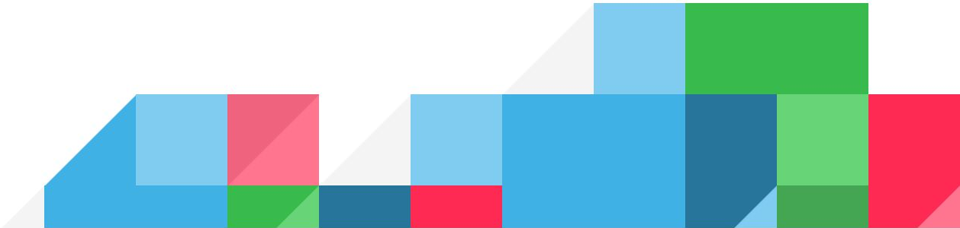
Life Without Helm (My Life Last June)
Write Kubernetes manifests by hand
Do this every time you need to release anything
Figure out your own sharing
Tweak resources by hand
Use kubectl to manage these

Slide 3
Kubernetes Helm
Collaboration with Google, Bitnami, Deis, others
The successor of Deis’ “Helm Classic”
Two parts:
Helm client
Tiller server

Slide 4
Helm’s Core Values
Installing resources in Kubernetes should be easy (like Apt/Yum/Homebrew)
Teams should be able to collaborate
Releases should be reproducible
Packages should be shareable

Slide 5
Basic Architecture
Render charts
Deploy
Interface for state tracking
Manage charts
Communicate with server
K8S API
Server
Helm Client
Tiller Server
REST
gRPC

Slide 6

Charts, Repositories, Releases
Chart: Think operating system package. A bundle of Kubernetes resource data.
Repository: A collection of released charts. Think npm, Ubuntu repository, etc.
Release: A chart instance is loaded into Kubernetes, it then becomes a release. (Same chart can be installed several times into the same cluster. Each will have its own release.)

Slide 7
Main Helm Commands
Init: Set up Helm for the first time (helm init)
Install: Install a chart (helm install alpine)
Get, Status, List: Find out about charts (helm list)
Repo Add, List, Remove, Index: Manage your helm repositories
Search: Search repos for charts
Create, Package: Create and package new charts

Slide 8
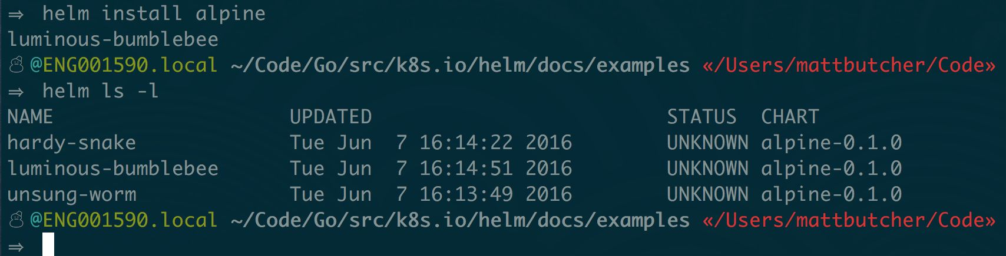
Installing a Chart (Demo)

Slide 9
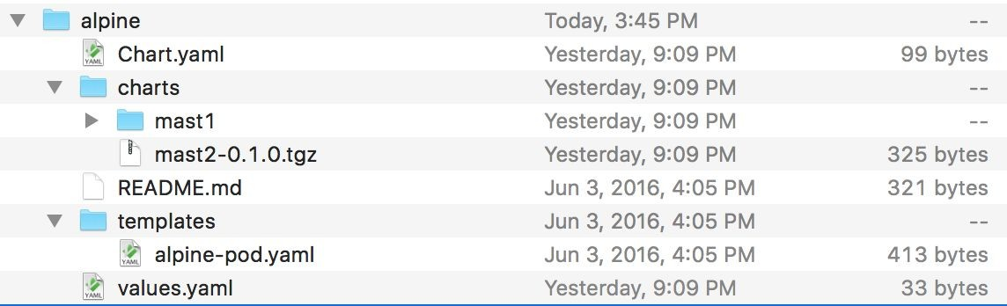
The Chart

Slide 10
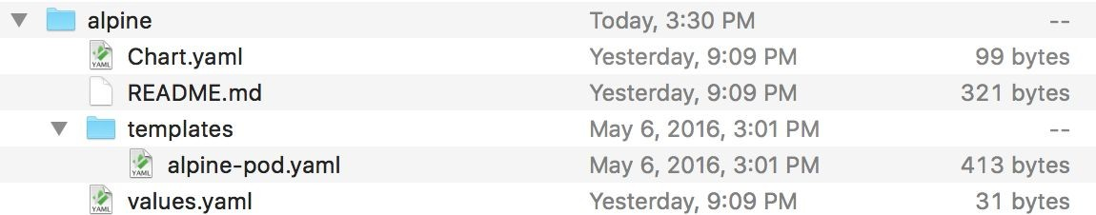
Chart.yaml

Slide 11
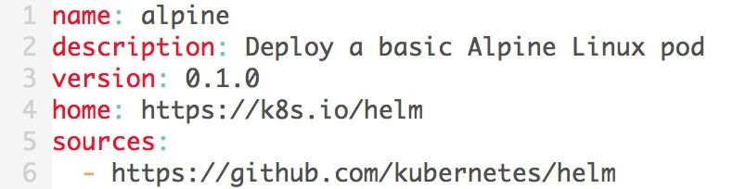
Chart.yaml
Simple YAML
About the chart
Used for…
Searching
Official name
Version information
Finding the source

Slide 12
Dependencies

Slide 13
Helm Dependencies
Immutability
Nested
Versioned
“Vendored”
Say I start with an app….
MyApp
...and it has some dependencies.

Slide 14
Helm Dependencies
MySQL
Reverse Proxy
MyApp
Redis

Slide 15
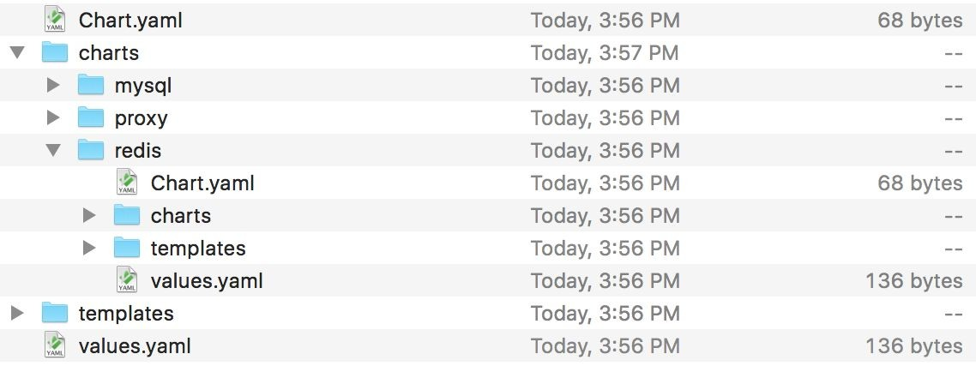
MyApp Dependencies

Slide 16
Templates

Slide 17
Helm Templates
The Go Template language ({{.foo | bar}})
Simple control structures (looping, conditionals, nesting)
50+ add-on functions
Compile phase, execution phase

Slide 18
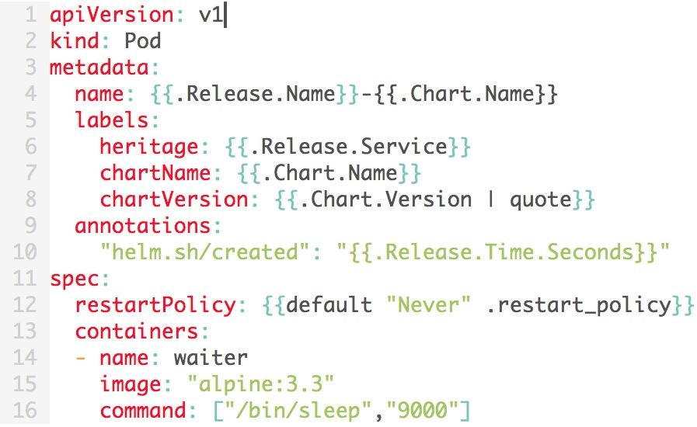
Templates

Slide 19
So how do we get values into templates?

Slide 20
Values

Slide 21
Values.yaml
Specify values that should be injected into templates
Simple YAML with “namespaces”
Each (nested) chart can have its own values.yaml file
You can specify overrides externally:
helm install -f myvalues.yaml yourchart

Slide 22
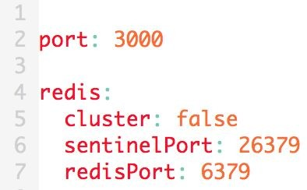
values.yaml
Global
Redis scope

Slide 23
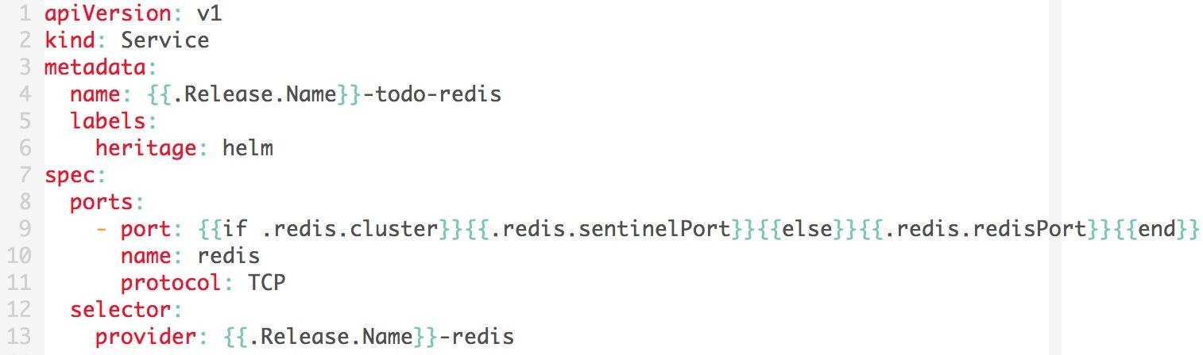
values.yaml
values.yaml
templates/rc.yaml

Slide 24
About Helm
http://github.com/kubernetes/helm
Part of CNCF
Contributions from around a dozen companies (plus individuals)
Roadmap in a nutshell:
Current: Helm 2.0.0-Alpha.1
Coming Soon: Alpha.2
“Light production use” by Beta.1
Production ready by 2.0.0

